Slide 1
Auction Price Prediction & Image Features
Presented by: Yifei Wang, Bingying (Echo) Liu

Slide 2



Auction Process
Highest price
Buyer’s premium
Item on sale
Bidding

Slide 3

Project goals
Sellers
Price prediction
Advertising
Auction arrangement
Estimate vehicle value
Interpretability
Increase expected price
Fix or not fix

Slide 4
Preprocess Data
Feature Extraction
Image Processing
Image Annotation
Final Model
Various Modelling Attempts
Timeline

Slide 5
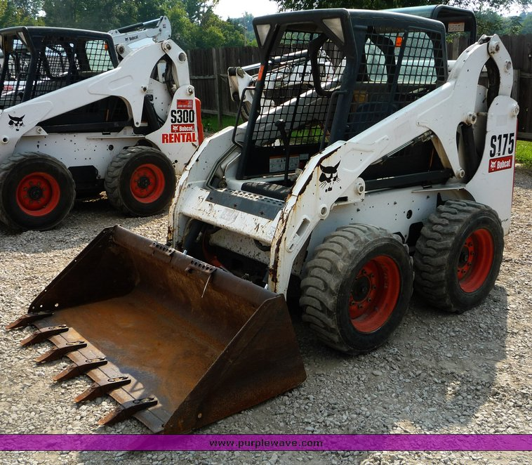
Preprocess Data
Extract
Features!
Text Data
Tire, bucket, engine, etc.
Tabular Data
Final auction price
Make, Year, Mileage, etc.
Non-annotated
Preprocess Data | Feature Extraction | Image Annotation | Final Model

Slide 6
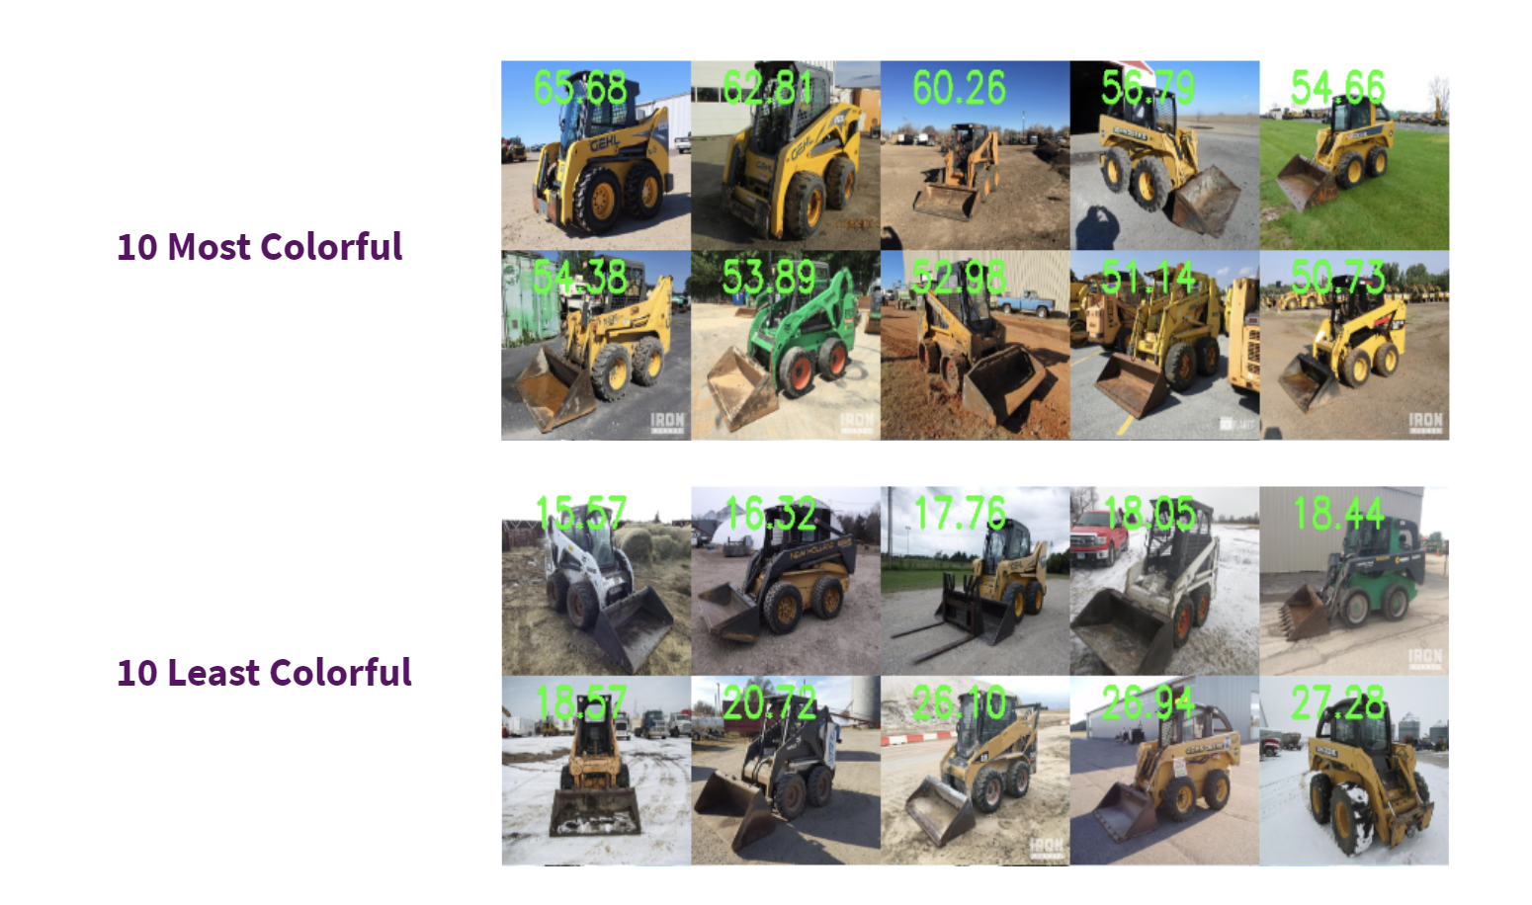
Feature: Colorfulness Scores
Preprocess Data | Feature Extraction | Image Annotation | Final Model

Slide 7
Feature: Text Sentiment
Lexicon and rule-based sentiment analysis tool
Preceding tri-grams (observe 90% negation flip); Conjunctions
VADER
Engine (more than 100 characters’ comments) | VADER Sentiment Scores
Engine access door latch area damaged, engine knocks, engine shroud damaged, new holland 450nc 5.01 four cylinder diesel engine | {‘neg’: 0.254, ‘neu’: 0.746, ‘pos’: 0.0, ‘compound’: -0.70}
81 hp, approximately one hour on replaced engine, new holland 445m2 four cylinder diesel engine, recently replaced engine | {‘neg’: 0.0, ‘neu’: 1.0, ‘pos’: 0.0, ‘compound’: 0.0}
70 hp, john deere 5030ht014 3.01 five cylinder turbo diesel engine, one engine cover side panel missing | {‘neg’: 0.121, ‘neu’: 0.879, ‘pos’: 0.0, ‘compound’: -0.296}
Engine compartment fire damage, john deere pe5030 four cylinder turbo diesel engine, lift arm cylinder pins removed, but included | {‘neg’: 0.183, ‘neu’: 0.817, ‘pos’: 0.0, ‘compound’: -0.4215}
Preprocess Data | Feature Extraction | Image Annotation | Final Model

Slide 8
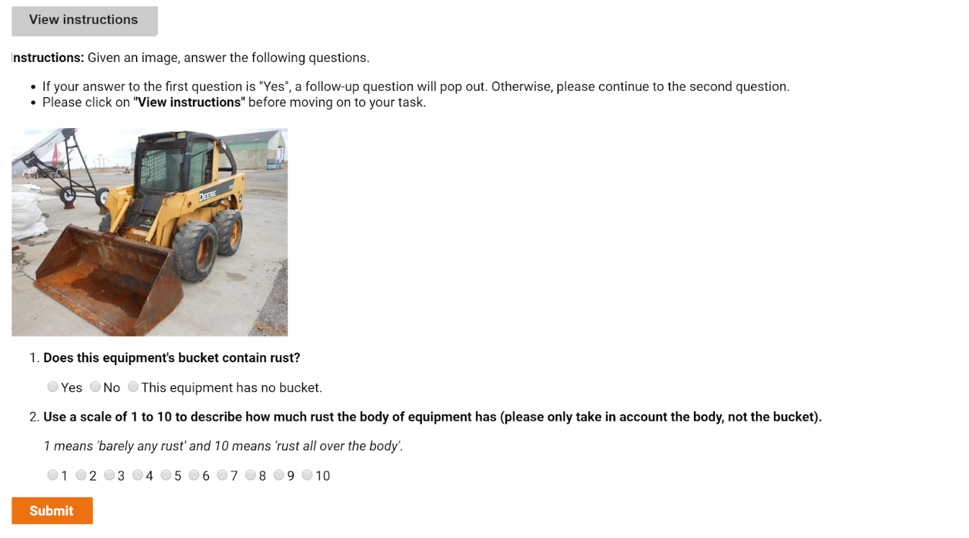




Image Annotation
Sample 100 images
13 questions/image
3 workers/question
$ 83.94 in total
13 questions
Yes-no & Quantitative
Background
Rust extent
Brightness of color
Dirt level
Preprocess Data | Feature Extraction | Image Annotation | Final Model

Slide 9
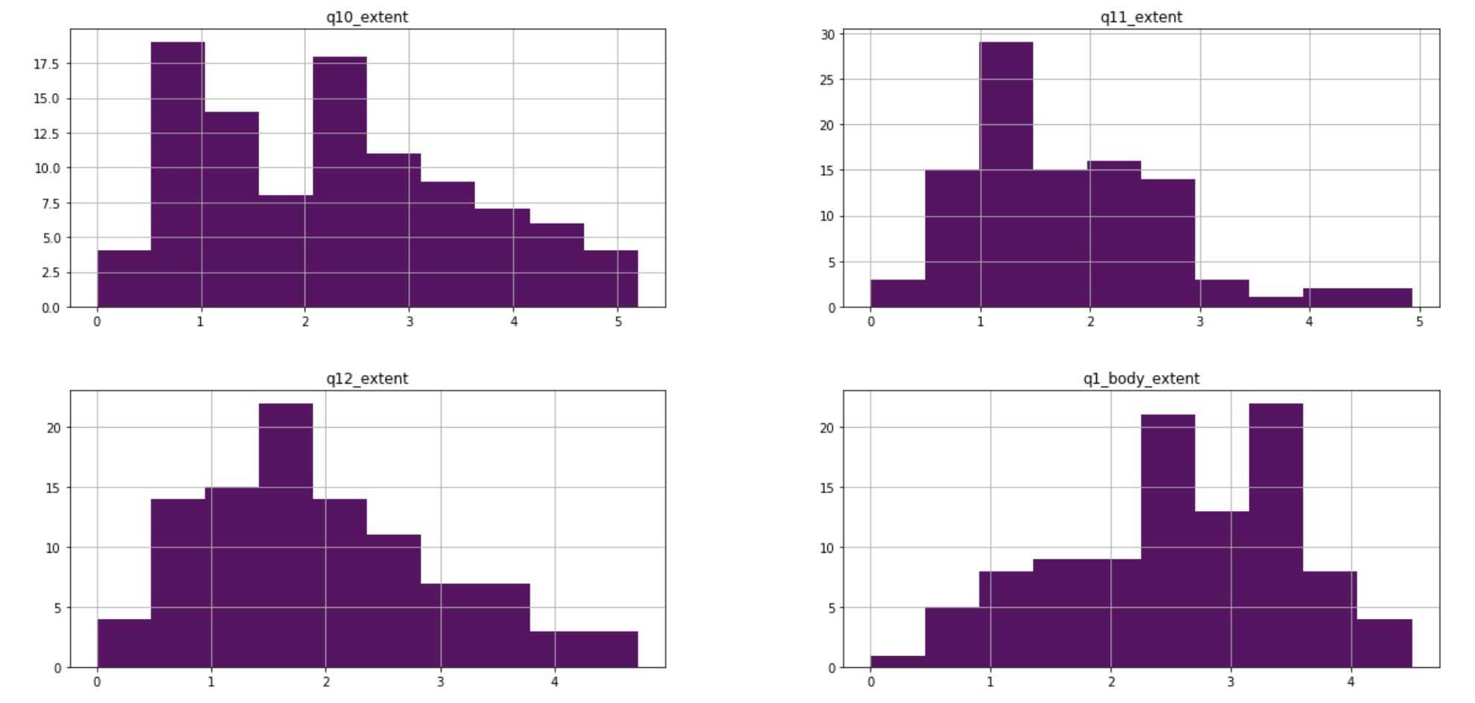
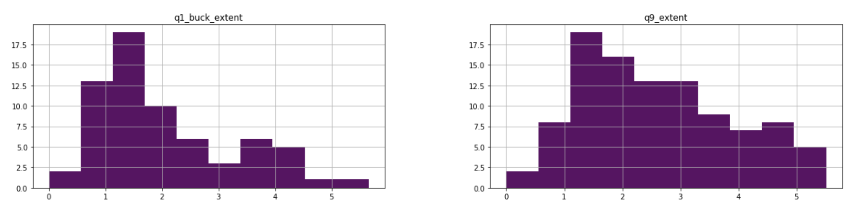
Annotation Quality:
Except for body rust extent, all other annotations are within 2-3 std dev away.
Distribution of Standard Deviations of All Numerical Answers for Each Image

Slide 10
Final Model
concat
Performance:
MAE: $2541.85
MAPE: 19.06%
Freeze + Fine-tune
2048
Image
Pretrained
resnet156
2163
32
Year
Make
Mileage
Colorfulness
etc.
Tabular (+ Annotation)
15
1
Price
100
Text
…, new factory remanufactured head, new ...
Preprocess Data | Feature Extraction | Image Annotation | Final Model

Slide 11
Interpretability - Images
Hard to generate quantitative interpretation on images
without enough human annotations
Try to qualitatively interpret images
Indicate which part of the image is driving up/down the price

Slide 12
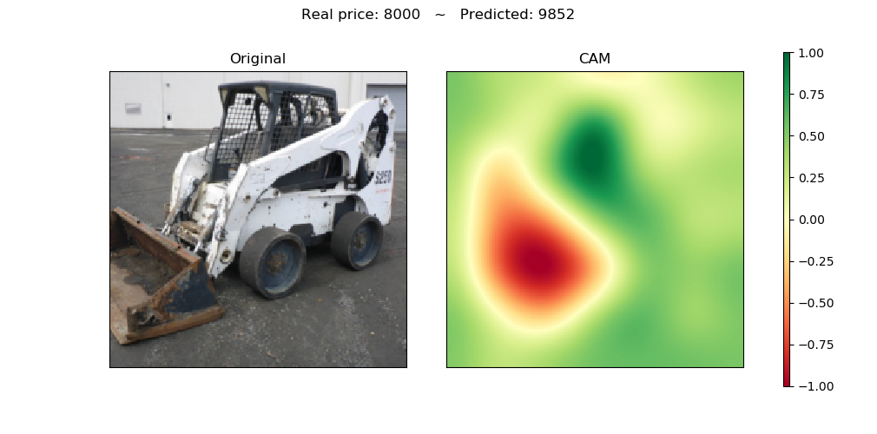
Interpretability - Attention Map
No scratch on body
Rusted
Clean background

Slide 13
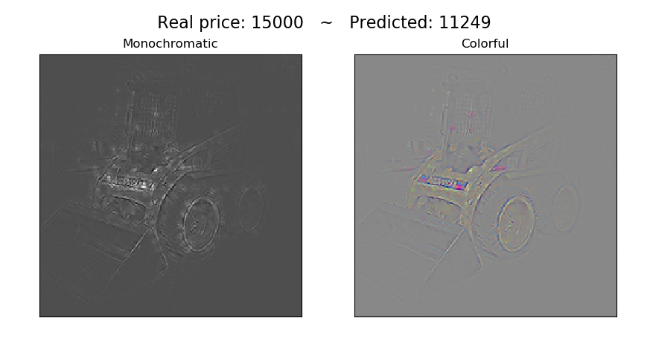
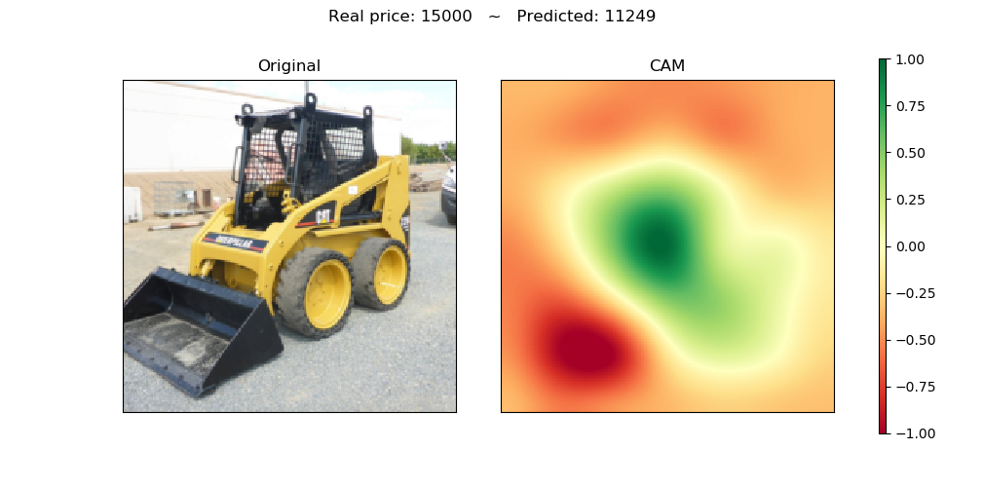
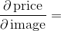
Interpretability - Saliency Map
Clear brand logo and clean body

Slide 14
Model | Parameters | Sample Size | R^2 | MAE
MLR | Hours_final, age_at_sale | 6167 | 0.392 | 4076
MLR | Hours_final, age_at_sale, parts_sentiment | 6167 | 0.395 | 4062
MLR | Hours_final, age_at_sale, colorfulness_score | 6167 | 0.396 | 4047
MLR | Hours_final, age_at_sale, month_of_sold_date | 6167 | 0.401 | 4066
MLR | Hours_final, age_at_sale, make | 6167 | 0.434 | 3926
MLR | Hours_final, age_at_sale, make, month_of_sold_date, colorfulness_score, parts_sentiment | 6167 | 0.442 | 3902
H2O_DRF | Hours_final, age_at_sale, make, month_of_sold_date, colorfulness_score, parts_sentiment | 6167 | 0.489 (MSE) | 3391
MLR | Hours_final, age_at_sale | 96 | 0.431 | 5384
MLR | Hours_final, age_at_sale, make | 96 | 0.570 | 4998
MLR | Hours_final, age_at_sale, make, mturk | 96 | 0.633 | Unstable Because of Overfitting
MLR | Hours_final, age_at_sale, make, mturk, parts_sentiment, colorfulness | 96 | 0.676
MLR | Hours_final, age_at_sale, make, mturk, parts_sentiment, colorfulness , month_sold | 96 | 0.802
H2O_DRF | Hours_final, age_at_sale, make, mturk, parts_sentiment, colorfulness , month_sold | 96 | 0.735 (MSE)
Model Comparisons

Slide 15
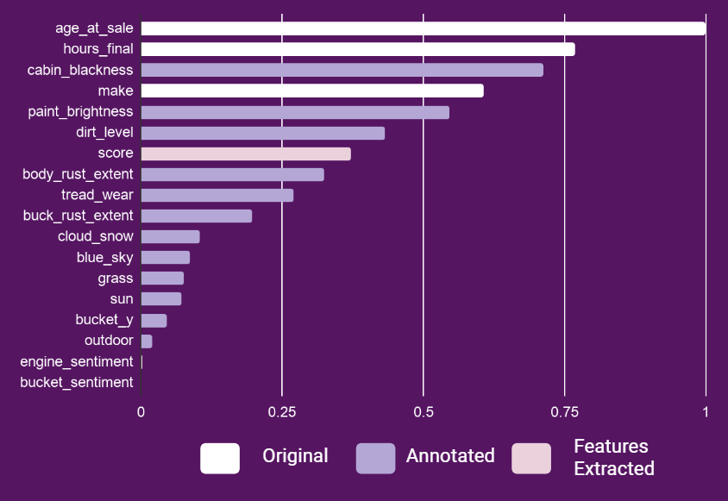
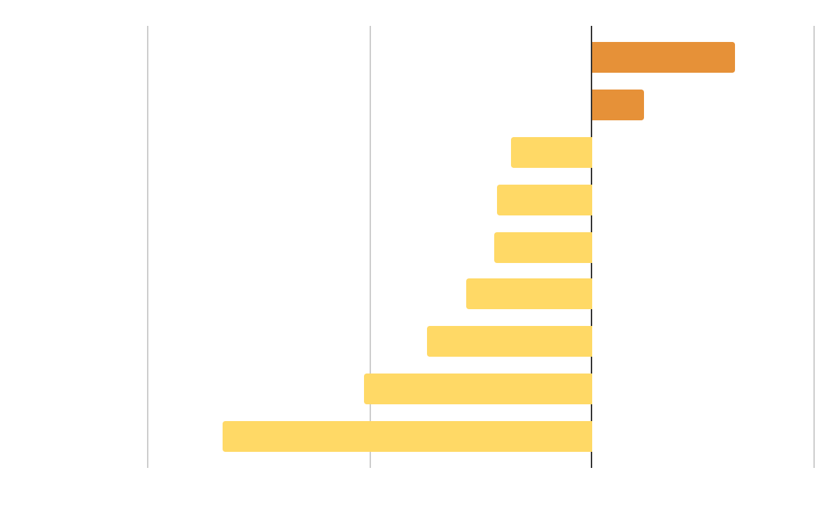
Brand Premium
Top Feature Importance
Final selling price is on log scale
* chart is based on coefficients of MLR
* Chart is based on distributed random forest
Seasonality Influence on Sales Price
Oct, Apr: Positive influence
Jan, Sep: Negative influence
Quantitative Interpretation

Slide 16

https://skidsteer-interpret.herokuapp.com/
Interactive Visualizations

Slide 17
Summary
Recommendations
Interpretable features
(machine and human)
Image annotation (MTurk)
Price prediction
Vehicle cleanliness

Slide 18
Thank you!
Yifei Wang & Bingying Liu

Slide 19
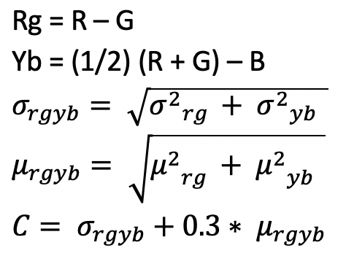
II. Feature Extraction - Image Colorfulness
Haslera and Susstrunk (2003)
They ask people to rate images using 7 categories of colorfulness
Propose a metric that correlates to 95.3% of the experiment data
Opponent color space representation

